Slide 1
World Happiness Report Findings
by Ben Nguyen
DS2001 TR 11:45-1:25

Slide 2
What will I be doing?
Analyze World Happiness Report from 2019 (data from Kaggle)
Geography/cultures always an interest

Slide 3
Why 2019?
2020 is a year like no other
Inconsistencies between years in dataset
2019 chosen to ensure complete year of data

Slide 4
What will I be talking about?
Happiest/unhappiest 20 countries
How some factors compared/influenced others
Numbers and comparisons

Slide 5
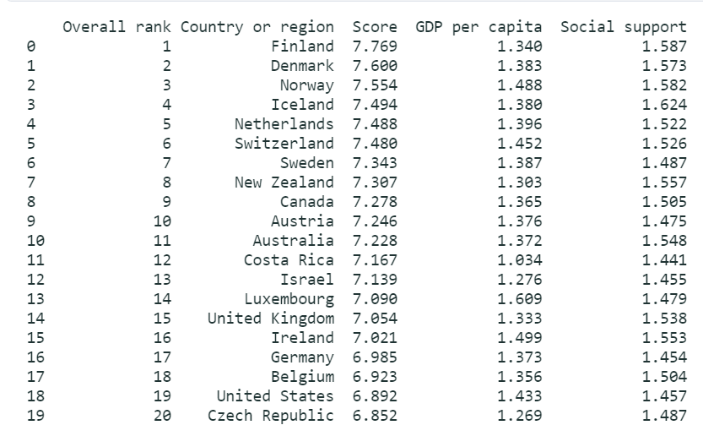
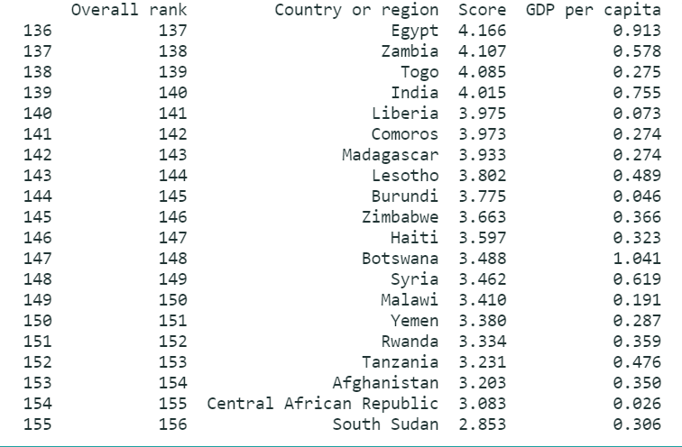
Highs and Lows

Slide 6
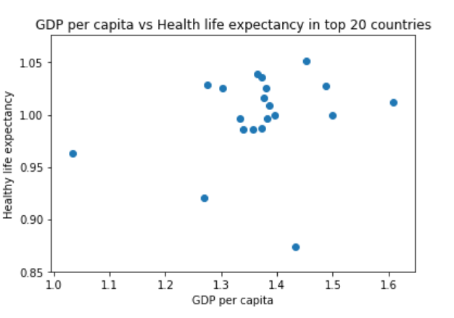
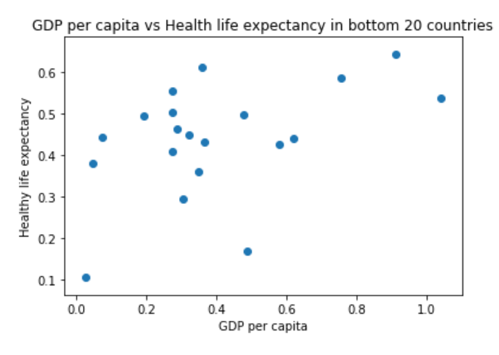
GDP v. Healthy Life Expectancy

Slide 7
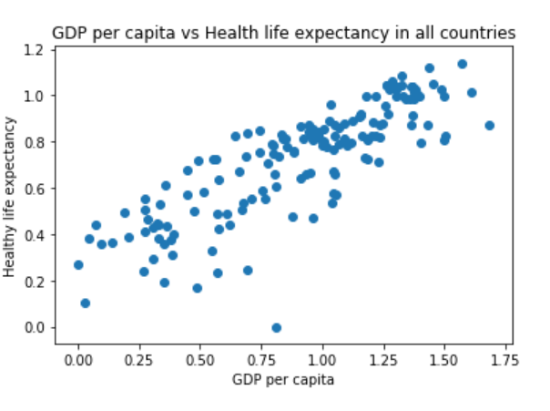

Slide 8
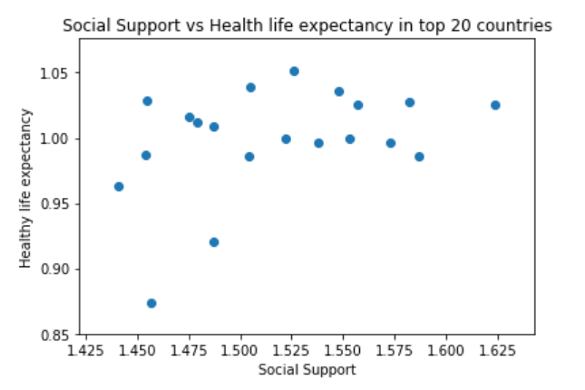
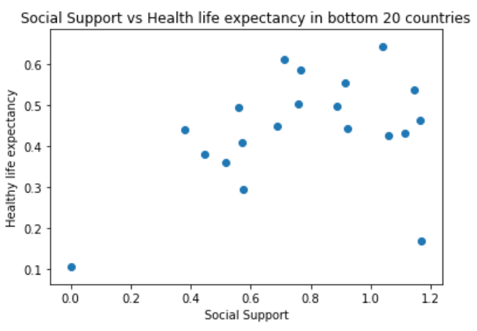
Social Support v. Healthy Life Expectancy

Slide 9
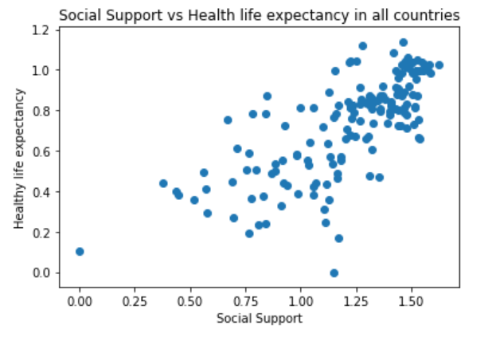

Slide 10
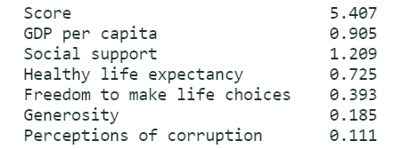
Crunching some numbers

Slide 11
What did we just talk about?

Slide 12
Thank you
Thank you for listening today
Stay safe everyone

